Slide 1
Java 4 WEB
Lesson 22

Slide 2
Lesson goals
Runnable
Data access synchronization
Callable, ExecutorService
java.util.concurrent.atomic and collections

Slide 3

Multitasking

Slide 4
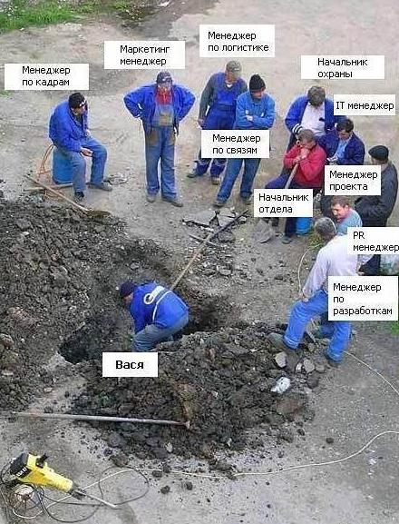
Multithreading

Slide 5
Thread
Thread – a smallest unit of execution that can be scheduled by the operating system.
Process – a group of associated threads that execute in the same, shared environment. The threads in the same process share the same memory space and can communicate directly with one another.
Task - a single unit of work performed by a thread

Slide 6
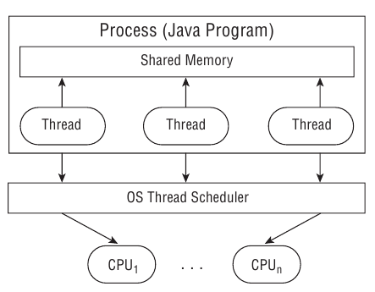
Process model

Slide 7
Thread scheduler and context switch
When a thread’s allotted time is complete but the thread has not finished processing, a context switch occurs. A context switch is the process of storing a thread’s current state and later restoring the state of the thread to continue execution. Often a cost associated with a context switch by way of lost time saving and reloading a thread’s state.
Thread can interrupt or supersede another thread with lower priority (minimum 1 and maximum 10)

Slide 8
Thread types
System - created by the JVM and runs in the background of the application (GC).
User-defined - one created by the application developer to accomplish a specific task.
Daemon - one that will not prevent the JVM from exiting when the program finishes. Both system and user-defined threads can be marked as daemon threads
Notes:
When a thread’s allotted time is complete but the thread has not finished processing, a context switch occurs. A context switch is the process of storing a thread’s current state and later restoring the state of the thread to continue execution. Often a cost associated with a context switch by way of lost time saving and reloading a thread’s state.
Thread can interrupt or supersede another thread with lower priority (minimum 1 and maximum 10)

Slide 9
Main Thread
Created automatically on program start
public static void main(String args[]) { Thread t = Thread.currentThread(); // ... }

Slide 10
Runnable
The Runnable interface is commonly used to define the work a thread will execute, separate from the main application thread
@FunctionalInterface public interface Runnable { void run(); }
Runnable r1 = () -> System.out.println("Hello World"); Runnable r2 = () -> {int i=10; i++;}; Runnable r3 = () -> {return;}; Runnable r4 = () -> {};

Slide 11
Creating a Thread
define the Thread with the corresponding task (Runnable) to be done by overriding method Runnable::run
start the task by using the Thread::start() method.
Java does not provide any guarantees about the order in which a thread will be processed once it is started.

Slide 12
Defining the task implementing Runnable
class PrintData implements Runnable { @Override public void run() { for (int i = 0; i < 3; i++) { System.out.println("Printing record: " + i);
} } public static void main(String[] args) { new Thread(new PrintData()).start(); } }

Slide 13
Defining the task extending Thread
class PrintData extends Thread { @Override public void run() { for (int i = 0; i < 3; i++) { System.out.println("Printing record: " + i);
} } public static void main(String[] args) { new PrintData().start(); } }

Slide 14
Extend thread vs Implement runnable
If you need own Thread rules upon which multiple tasks will rely, such as a priority Thread, extending Thread may be preferable.
Extending Thread does not allow you to extend any other class, whereas implementing Runnable lets you extend another class.
Implementing Runnable is often a better object-oriented design practice since it separates the task being performed from the Thread object performing it.
Implementing Runnable allows the class to be used by numerous Concurrency API classes.

Slide 15
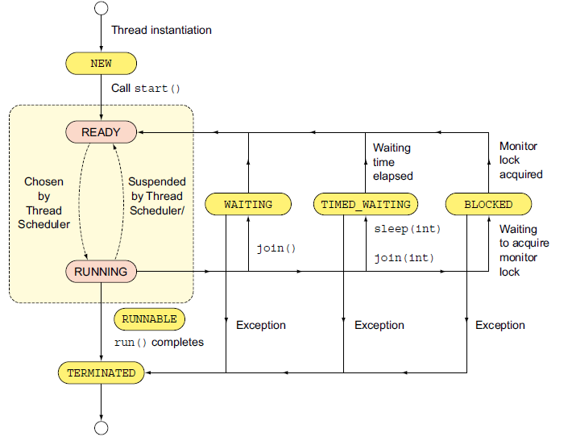
Thread lifecycle

Slide 16
What is the output?
class PrintData extends Thread { @Override public void run() { for (int i = 0; i < 3; i++) System.out.println("Printing record: " + i); } public static void main(String[] args) { new Thread(new PrintData()).run(); new Thread(new PrintData()).run(); new Thread(new PrintData()).run(); } }

Slide 17
What is the output?
class PrintData extends Thread { @Override public void run() { for (int i = 0; i < 3; i++) System.out.println("Printing record: " + i); } public static void main(String[] args) { new Thread(new PrintData()).start(); new Thread(new PrintData()).start(); new Thread(new PrintData()).start(); } }

Slide 18


Synchronizing problem
MyThread train1 = new MyThread();
MyThread train2 = new MyThread();
train1.start();
train2.start();
Write to the same file
Change an object, a variable
etc.

Slide 19
Synchronizing problem
Thread1
Thread2
Thread3
Monitor
Resource

Slide 20
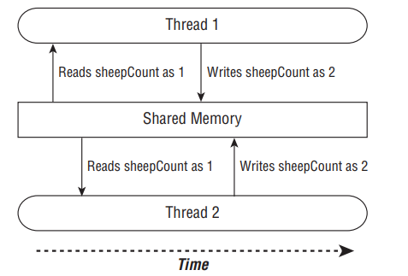
Synchronizing problem

Slide 21
Synchronizing problem
Thread 1 (increment) | Thread 2 (decrement)
1: Retrieve c (0) | 2: Retrieve c (0)
3: 0 + 1 = 1 | 4: 0 – 1 = -1
5: Store result; c = 1 | 6: Store result; c = -1
class Counter {
private int c = 0;
public void increment() {
c = c + 1;
}
public void decrement() {
c = c - 1;
}
}

Slide 22
Synchronizing problem
class Counter {
private int c = 0;
public synchronized void increment() {
c = c + 1;
}
public synchronized void decrement() {
c = c - 1;
}
}
Thread 1 (increment) | Thread 2 (decrement)
1: Retrieve c (0)
2: 0 + 1 = 1
3: Store result; c = 1
 | 4: Retrieve c (1)
 | 5: 1 – 1 = 0
 | 6: Store result; c = 0

Slide 23
The Volatile Keyword
The Java volatile keyword is used to mark a Java variable as "being stored in main memory". More precisely that means, that every read of a volatile variable will be read from the computer's main memory, and not from the CPU cache, and that every write to a volatile variable will be written to main memory, and not just to the CPU cache.
public class SharedObject {
public volatile int counter = 0;
}

Slide 24
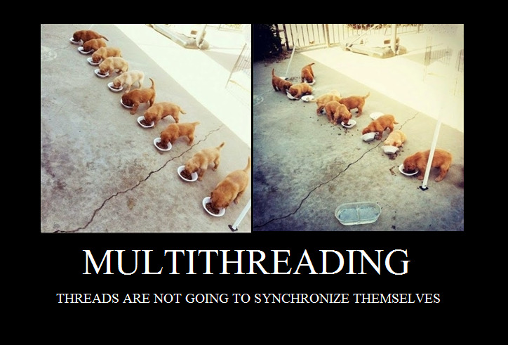
Synchronized Blocks

Slide 25
Synchronized Blocks
A monitor is a structure that supports mutual exclusion or the property that at most one thread is executing a particular segment of code at a given time
PuppyManager manager = new PuppyManager(); synchronized(manager) { // Work to be completed by one thread at a time }

Slide 26
Synchronized
class PuppyManager { private int puppyCount = 0; private void incrementAndReport() { synchronized (this) { System.out.print((++puppyCount) + " "); } } public static void main(String[] args) { ExecutorService service = null; try { service = Executors.newFixedThreadPool(20); PuppyManager manager = new PuppyManager(); for (int i = 0; i < 10; i++) service.submit(manager::incrementAndReport); } finally { if (service != null) service.shutdown(); } } }

Slide 27
Synchronized
class PuppyManager { private int puppyCount = 0;
private synchronized void incrementAndReport() { System.out.print((++ puppyCount ) + " "); }
public static void main(String[] args) { ExecutorService service = null; try { service = Executors.newFixedThreadPool(20); PuppyManager manager = new PuppyManager(); for (int i = 0; i < 10; i++) service.submit(manager::incrementAndReport); } finally { if (service != null) service.shutdown(); } } }

Slide 28
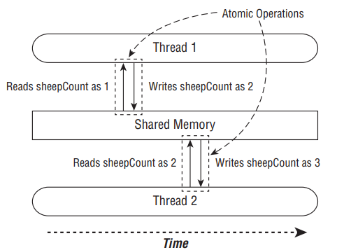
java.util.concurrent.atomic
Atomic is the property of an operation to be carried out as a single unit of execution without any interference by another thread.
Using the atomic classes ensures that the data is consistent between workers and that no values are lost due to concurrent modifications.

Slide 29
java.util.concurrent.atomic
AtomicBoolean
AtomicInteger
AtomicIntegerArray
AtomicLong
AtomicLongArray
AtomicReference
AtomicReferenceArray

Slide 30
Syncronization using atomic
class PuppyManager { private AtomicInteger puppyCount = new AtomicInteger(); private void incrementAndReport() { System.out.print((puppyCount.incrementAndGet()) + " "); } public static void main(String[] args) { ExecutorService service = null; try { service = Executors.newFixedThreadPool(20); PuppyManager manager = new PuppyManager(); for (int i = 0; i < 10; i++) service.submit(manager::incrementAndReport); } finally { if (service != null) service.shutdown(); } } }

Slide 31
ExecutorService
ExecutorService service = Executors.newSingleThreadExecutor(); System.out.println("begin"); service.execute(() -> System.out.println("Printing zoo inventory")); service.execute(() -> {
for(int i=0; i<3; i++) System.out.println("Printing record: "+i);
}); service.execute(() -> System.out.println("Printing zoo inventory")); System.out.println("end");
begin
Printing zoo inventory
Printing record: 0
Printing record: 1
end
Printing record: 2
Printing zoo inventory

Slide 32
Callable
@FunctionalInterface public interface Callable<V> { V call() throws Exception; }
Similar to Runnable except that its call() method returns a value and can throw a checked exception

Slide 33
Callable
public static void main(String[] args) throws InterruptedException, ExecutionException { ExecutorService service = null; try { service = Executors.newSingleThreadExecutor(); Future<Integer> result = service.submit(() -> 30+11); System.out.println(result.get()); } finally { if(service != null) service.shutdown(); } }

Slide 34
Submit vs Execute
execute(Runnable r) - void, “fire-and-forget”
Future<T> submit(Runnable r) - returns a Future object, allows Callable
prefer submit() over execute(),

Slide 35
Future - Waiting for Results
Future future = service.submit(() -> System.out.println("Hello Zoo"));
boolean isDone() - returns true if the task was completed, threw an exception, or was cancelled.
boolean isCancelled()- returns true if the task was cancelled before it completely normally.
boolean cancel() - attempts to cancel execution of the task.
V get() - retrieves the result of a task, waiting endlessly if it is not yet available.
V get(long timeout, TimeUnit unit) - retrieves the result of a task, waiting the specified amount of time. If the result is not ready by the time the timeout is reached, a checked TimeoutException will be thrown.

Slide 36
ExecutorService shutdown
ExecutorService service = null; try { service = Executors.newFixedThreadPool(3); System.out.println("before submit"); Future<Integer> result = service.submit(new Factorial(10)); System.out.println("after submit"); System.out.println(result.get()); System.out.println("after result"); } catch (InterruptedException | ExecutionException e) { e.printStackTrace(); } finally { if (service != null) { service.shutdown(); } }
class Factorial implements Callable<Integer>{ private int n; public Factorial(int n) { this.n = n; } @Override public Integer call(){ return IntStream.rangeClosed(1, n) .reduce(1, (n1, n2) -> n1 * n2); } }

Slide 37
Scheduling Tasks
ScheduledExecutorService service = Executors.newSingleThreadScheduledExecutor();
schedule(Callable callable, long delay, TimeUnit unit) - Creates and executes a Callable task after the given delay
schedule(Runnable command, long delay, TimeUnit unit) - Creates and executes a Runnable task after the given delay
scheduleAtFixedRate(Runnable command, long initialDelay, long period, TimeUnit unit) - Creates and executes a Runnable task after the given initial delay, creating a new task every period value that passes.
scheduleAtFixedDelay(Runnable command, long initialDelay, long delay, TimeUnit unit) - Creates and executes a Runnable task after the given initial delay and subsequently with the given delay between the termination of one execution and the commencement of the next

Slide 38
Thread pool creation
A thread pool is a group of pre-instantiated reusable threads that are available to perform a set of arbitrary tasks
Executors.newSingleThreadExecutor() single-threaded with single worker. Results are processed sequentially in the order in which they are submitted.
Executors.newSingleThreadScheduledExecutor() single-threaded executor that can schedule commands to run after a given delay or to execute periodically.
Executors.newCachedThreadPool() thread pool that creates new threads as needed, but will reuse previously constructed threads when they are available.
Executors.newFixedThreadPool(int nThreads) thread pool that reuses a fixed number of threads operating off a shared unbounded queue.
Executors.newScheduledThreadPool(int nThreads) thread pool that can schedule commands to run after a given delay or to execute periodically.

Slide 39
Concurrent Collections
public class ZooManager { private Map<String, Object> foodData = new HashMap<String, Object>(); public synchronized void put(String key, String value) { foodData.put(key, value); } public synchronized Object get(String key) { return foodData.get(key); } }

Slide 40
Concurrent Collections
public class ZooManager { private Map<String, Object> foodData = new ConcurrentHashMap<String, Object>(); public void put(String key, String value) { foodData.put(key, value); } public Object get(String key) { return foodData.get(key); } }

Slide 41

Deadlock
Thread1
synchronized
Thread2
synchronized
synchronized
synchronized

Slide 42
Deadlock example
class A { synchronized void methodA(B b) { b.doSomething(); } synchronized void doSomething() { ...} } class B { synchronized void methodB(A a) { a.doSomething(); } synchronized void doSomething() { ...} }

Slide 43
Literature
Concurrency (by Baeldung)
Concurrency (by Oracle)
Concurrency (by Howtodoinjava)

Slide 44
Homework Task 1
Implement a web-program that creates a connection to the URL passed as input from browser, receives the content of this html page. Find all the links (<a href=...>) in html, and log to file
count of working links (the HTTP response code is 2хх);
count of redirect links (code the answer is 3xx);
count of "non-working" (4xx, 5xx http status code).
Crawl all images from links responded with 200. Show these images on user browser. Show use threads count and crawling time in single-thread mode and multi-threaded mode (max thread count should be configurable from UI).

